Slide 1




NETFLIX CONTENT ANALYTICS
Cinematic Motion-Texture Theme
RESHMA S NATH

Slide 2


DESCRIPTIVE ANALYSIS ON NETFLIX CONTENT

Slide 3
INTRODUCTION
• Total Titles: 8807
• Movies: 6131
• TV Shows: 2676
• 100+ countries represented
• Multiple decades covered
Netflix is a leading global streaming platform offering movies, TV shows, and original content across many countries.
Data analytics plays a key role in understanding content distribution, audience preferences, and growth trends.
This study uses a Power BI dashboard to visually analyze Netflix’s content library by type, genre, rating, country, and year.
The analysis helps in understanding how Netflix expands its catalog and maintains competitiveness in the global market.

Slide 4

Dataset Overview
1. TO ANALYZE NETFLIX’S CONTENT
DISTRIBUTION :
Understand how movies, TV shows, genres, and ratings are structured across the platform.
• Total Titles: 8807
• Movies: 6131
• TV Shows: 2676
• 100+ countries represented
• Multiple decades covered
2. TO IDENTIFY GLOBAL CONTENT PATTERNS AND GROWTH TRENDS :
Examine country contributions, regional diversity, and year-wise expansion of the catalog.
OBJECTIVES OF THE STUDY
3. TO DERIVE STRATEGIC INSIGHTS FOR DECISION-MAKING :
Provide meaningful conclusions that support content planning, audience targeting, and market expansion strategies.

Slide 5
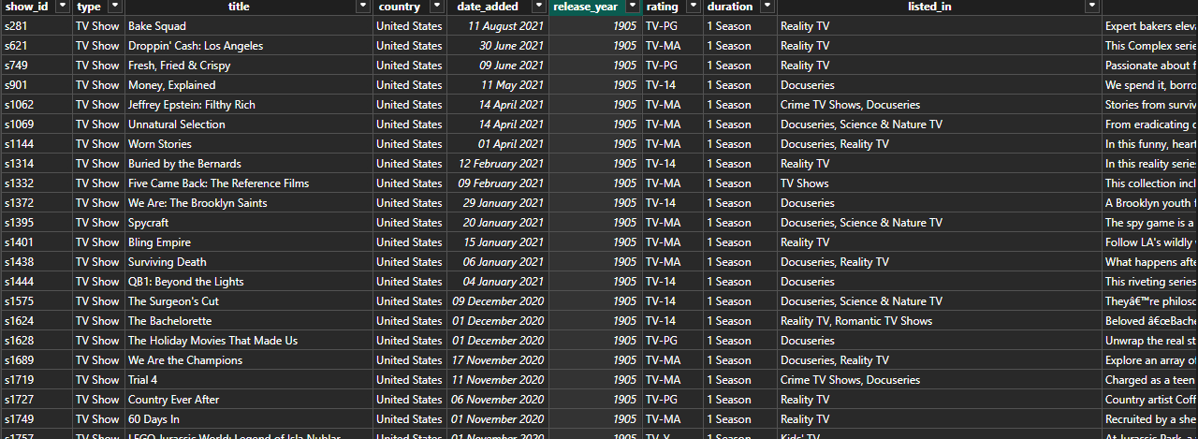
DATASET :

Slide 6
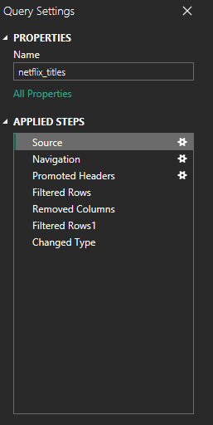
Data Cleaning Steps Performed
Duplicate records were removed to avoid double counting.
Missing or inconsistent values were handled appropriately.
Duration values stored as text (for example, “90 min”) were processed and converted into numeric form.
Unnecessary or inconsistent formatting in text fields was corrected.
Data types were standardized for numerical and categorical columns.

Slide 7
Top Contributing Countries
KEY DETAILS
Number of Rows : 7970
Number of Columns : 10
• United States: 3689 titles
• India: 1046 titles
• United Kingdom: 804 titles
• Canada: 445 titles
• France: 393 titles
• Japan: 318 titles
• Spain: 232 titles
COLUMN NAME | DESCRIPTION
Show_id | Unique identifier assigned to each Netflix title.
Type | Indicates whether the title is a Movie or TV Show.
Title | Name of the movie or TV series.
Country | Country or countries where the title was produced.
Date_added | The date the title was added to Netflix.
Release_year | Year in which the title was originally released.
Rating | Content rating such as TV-MA, PG-13, R, etc.
Duration | Length of the movie in minutes or number of seasons for TV shows.
Listed_in | Genre(s) or categories assigned to the title.
Description | Brief summary or synopsis of the title.

Slide 8
Top Contributing Countries
NEW MEASURES :
Top Genres = COUNTAX(VALUES(netflix_titles[listed_in]),netflix_titles[listed_in])
• United States: 3689 titles
• India: 1046 titles
• United Kingdom: 804 titles
• Canada: 445 titles
• France: 393 titles
• Japan: 318 titles
• Spain: 232 titles
Total Movies =
CALCULATE(COUNTROWS(netflix_titles), netflix_titles[type]="Movie")
Total TV Shows =
CALCULATE(COUNTROWS(netflix_titles), netflix_titles[type] = "TV Show")
Total Titles =
COUNTROWS(netflix_titles)

Slide 9
Top Contributing Countries
NEW COLUMN :
Duration (Minutes) =
VAR DurationText = netflix_titles[duration]
VAR Minutes =
IF(
SEARCH("min", DurationText, 1, 0) > 0,
VALUE(LEFT(DurationText, SEARCH("min", DurationText, 1, 0) - 1)),
BLANK()
)
RETURN Minutes
• United States: 3689 titles
• India: 1046 titles
• United Kingdom: 804 titles
• Canada: 445 titles
• France: 393 titles
• Japan: 318 titles
• Spain: 232 titles

Slide 10

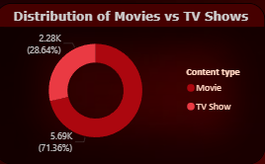
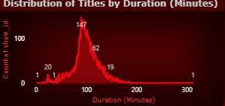
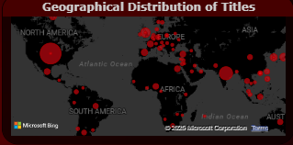
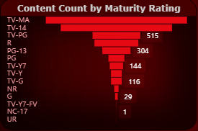
Title: Distribution of Movies vs TV Shows
Visual Type: DONUT CHART
Fields Used:
Legend: Content Type (Movie, TV Show)
Values: Count of Title ID
Title: Distribution of Titles by Duration (Minutes)
Visual Type: AREA CHART
Fields Used:
X-axis: Duration (Minutes)
Y-axis: Count of Titles
Title: Geographical Distribution of Titles
Visual Type: MAP
Fields Used:
Location: Country
Size / Values: Count of Title ID
Title: Content Count by Maturity Rating
Visual Type: FUNNEL CHART
Fields Used:
Y-axis: Maturity Rating (TV-MA, TV-14, PG-13, etc.)
X-axis: Count of Title ID

Slide 11
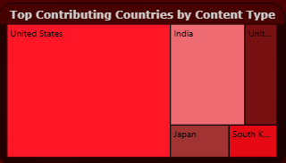
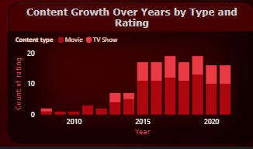

Top Contributing Countries
Title: Top Contributing Countries by Content Type
Visual Type: TREEMAP
Fields Used:
Group: Country
Details: Content Type (Movie, TV Show)
Values: Count of Title ID
Title: Content Growth Over Years by Type and Rating
Visual Type: STACKED COLUMN CHART
Fields Used:
X-axis: Release Year
Y-axis: Count of Titles
Legend: Content Type (Movie, TV Show)
• United States: 3689 titles
• India: 1046 titles
• United Kingdom: 804 titles
• Canada: 445 titles
• France: 393 titles
• Japan: 318 titles
• Spain: 232 titles

Slide 12
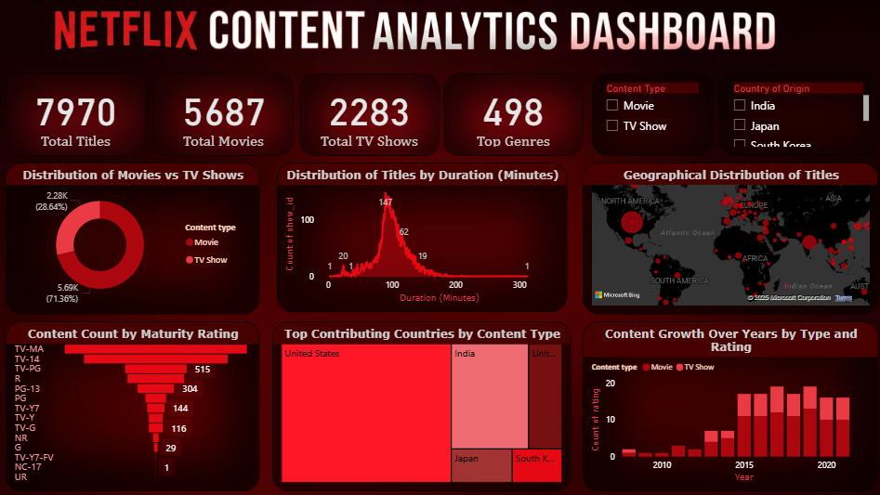

Slide 13
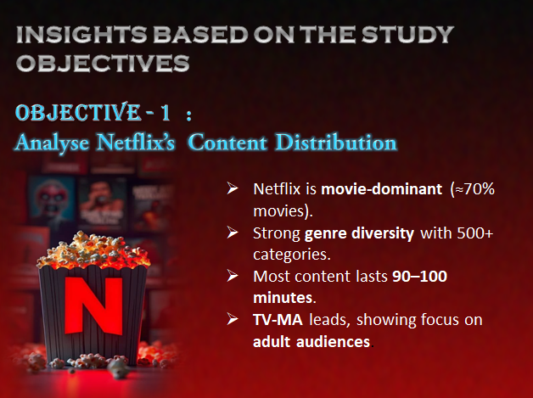

Slide 14
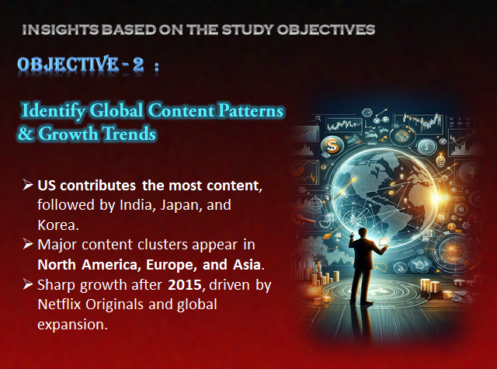

Slide 15

Maturity Rating Distribution
• TV-MA: 3207 titles
• TV-14: 2160 titles
• TV-PG: 863 titles
• R: 799 titles
• PG-13: 490 titles
• TV-Y7: 334 titles
• TV-Y: 307 titles

Slide 16
CONCLUSION
Duration Insights
Netflix’s content library is dominated by movies, with a strong focus on adult and teen audiences.
The United States contributes the highest number of titles, followed by strong growth from countries like India and other Asian regions.
A significant increase in content after 2015 reflects Netflix’s global expansion and focus on original productions.
Overall, the analysis shows Netflix as a data-driven platform that leverages genre diversity and global sourcing to enhance viewer engagement and sustain long-term growth.
• Movies mostly 80–120 minutes
• TV shows usually 1–2 seasons
• Short films increasing post-2018

Slide 17


reference
https://www.kaggle.com/datasets/shivamb/netflix-shows
Visualization Tool

Slide 18

THANK YOU

